Slide 2
Context
The API only creates an Excel CSV
It does not create the sas import code
We need to exploit the SAS file, with the correct settings, from a manual export so that the manual download CSV and the API generated CSV have the same variables
Otherwise, the SAS file will contain variables that do not exist in the API CSV and will cause the data to become misaligned with its respective variables

Slide 3
Free Text Fields
Resolved
Strip the newline ascii character from the file
For dates, confirm that the informat and format match the date as it appears in the log.
Free text fields can contain special characters that conflict with delimiters and cause a mismatch between variables and their contents, i.e. the data delimits early and shifts all following data to the right by 1 column for each conflict.

Slide 4
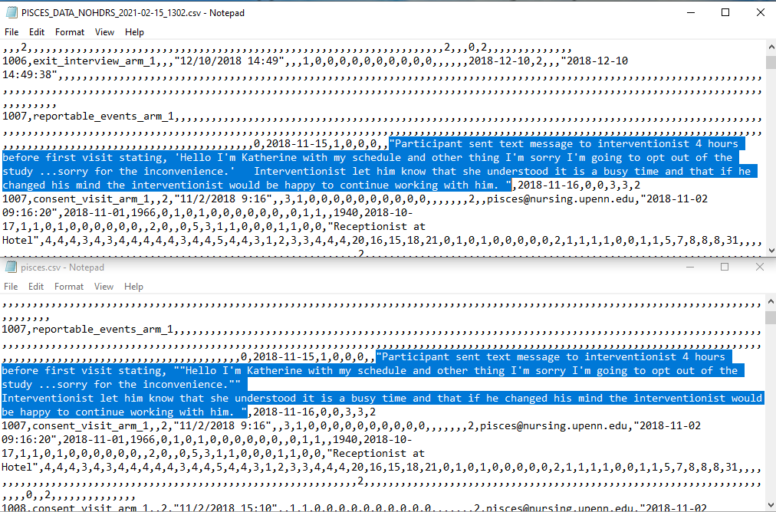
The 1st file is a manual download and the 2nd file is API generated
a

Slide 5
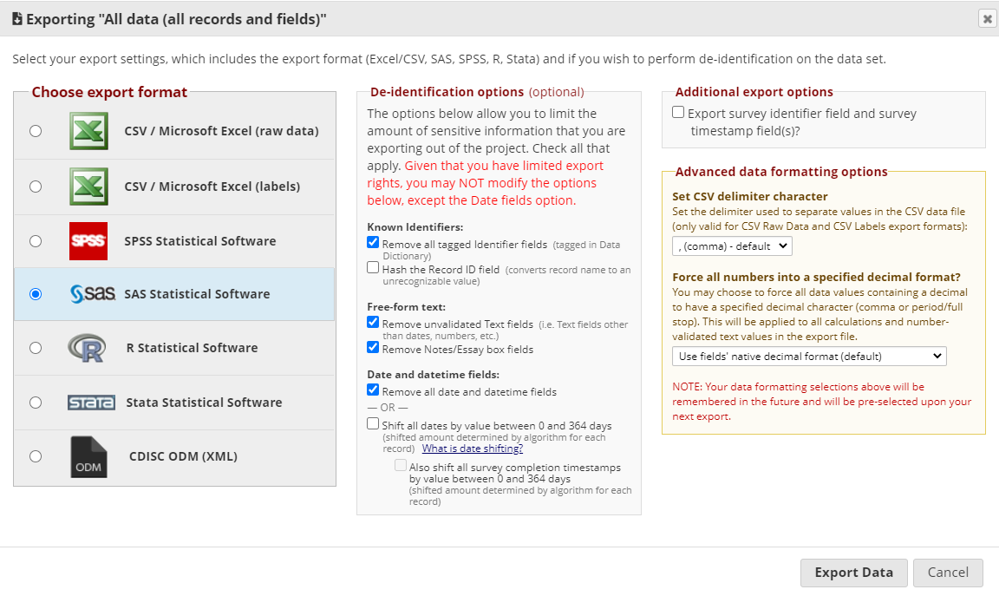
API Export with access to deidentified data needs the following enabled for accurate SAS import code

Slide 6
survey time

